Slide 1

Using Interwoven
Campus Crusade for Christ, Canada

Slide 2
What is interwoven
The Company
  What types of companies depend on Interwoven? Nearly half of the US Fortune 100, including eight of the Fortune 10.
  Boeing, General Electric, Coca-Cola, US Postal Service, American Airlines… etc.
The Products
  TeamSite
  OpenDeploy
  DataDeploy
  MetaTagger
  OpenSyndicate
  FrontOffice

Slide 3
Why Interwoven
Save Time
  Workflows and Scripts can be created to automate processes
  MetaTagger & OpenSyndicate
Work Together
  Common location makes working together important
  Common location makes working together easier
Locked In
  The product is bought, installed and WILL be used
  Get used to it, make suggestions, then give us a chance to make it happen

Slide 4
Quick Glossary
Branch
  Contains a single website
  Located on the TeamSite Server in Orlando, FL
  Contains Workareas, a Staging Area, Editions, and may contain sub-branches
Workarea
  A virtual copy of the branch
  Allows users to create files and see what they will look like, without messing up anyone else’s work
  Requires the owner of the workarea to “promote” the change to “staging”

Slide 5
Quick Glossary
Staging
  Where content from different Workareas is integrated and tested
  Read-only, cannot be changed directly in staging
  Holds files without effecting the production website
  One Staging area per branch
Edition
  Read-only snapshots of the web site at various points in its development
  May be deployed to the production server by an Editor and above

Slide 6
Roles
Editor
  More complex GUI (Webdesk Pro)
  More things to do, more things to break
  Own Workareas
Author
  Nicer GUI (Webdesk)
  Can’t break anything
Administrator & Master
  TruthMedia & Orlando CS team at this point
  Editors can be trained in the future.
  Can delete the branch (Bye bye Website, sort of)

Slide 7
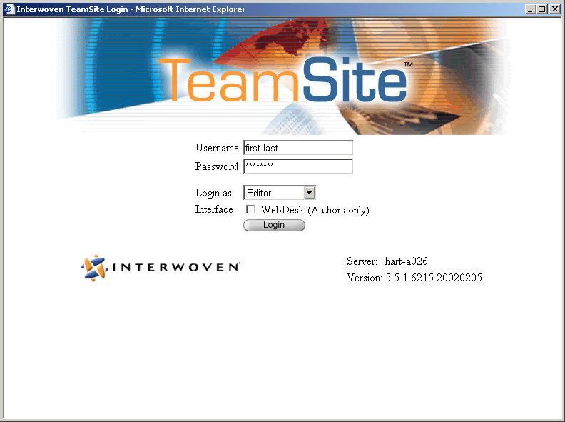
The Login Screen

Slide 8
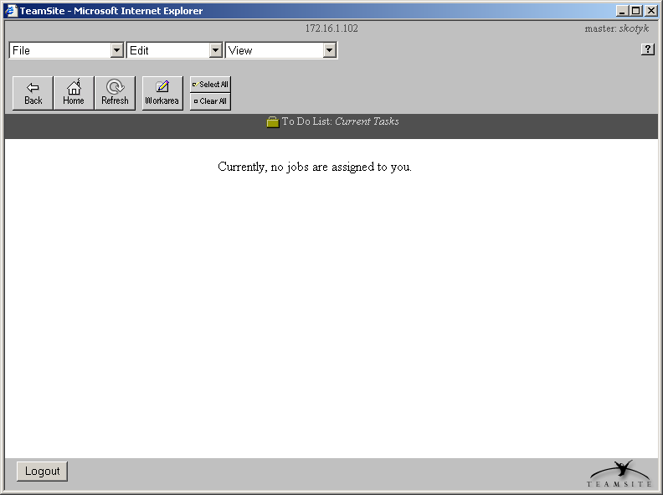
To Do List (Workflow View)

Slide 9
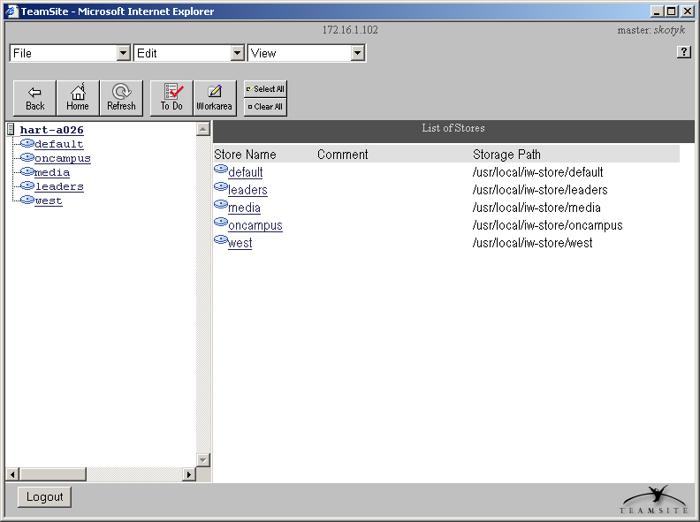
Workarea (Branch View)

Slide 10
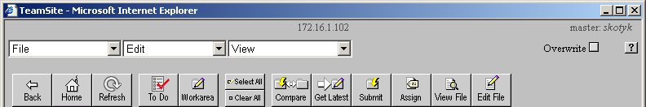
Editor’s Toolbar
Toolbar
  Contains the most frequently used commands
Menubar
  Drop down boxes. Will only display options if available

Slide 11
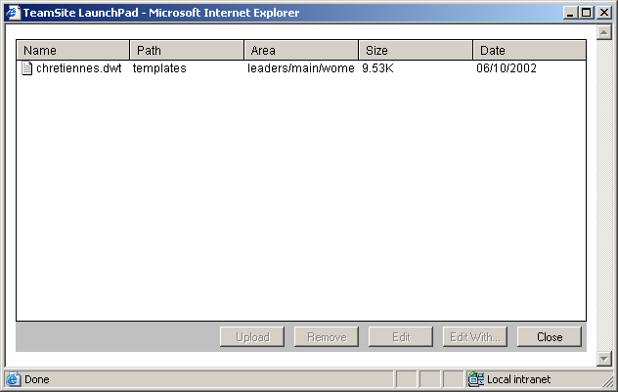
LaunchPad
LaunchPad is a helper applet which manages the file types and the application that edits them.
  Example: html files are edited with Dreamweaver.
  Gif files are edited with Fireworks.

Slide 12
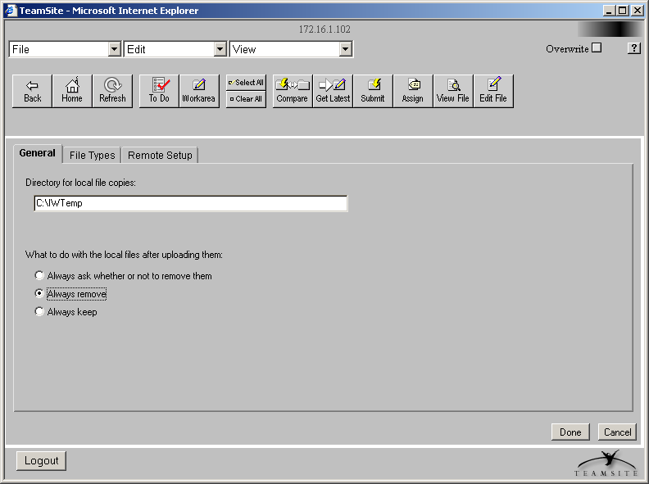
LaunchPad Admin
For now, you will be using the Remote Edit Mode
  When edit is clicked, launchpad will download the file to your computer
  After saving, you must upload the file back before you can submit

Slide 13
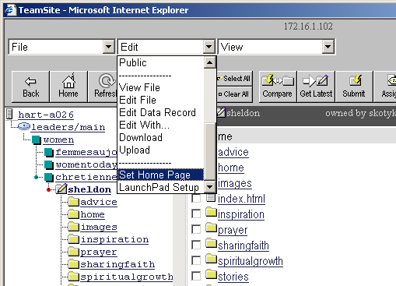
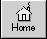
Setting your Home Page
To choose where you want to appear when you first log in
  Navigate to the area you want your home page to be
  Select Edit > Set Home Page
  To return to your home page, click the home button

Slide 14
Basics of TeamSite Collaboration
Work being done in workareas does not affect that of others.
The staging area holds one integrated version of the entire web site
Editors can use the Get Latest command to retrieve files that others have submitted to the staging area
Editors can use the Submit command to version and integrate work
Note: Until the change has been submitted to staging, it is NOT versioned.

Slide 15
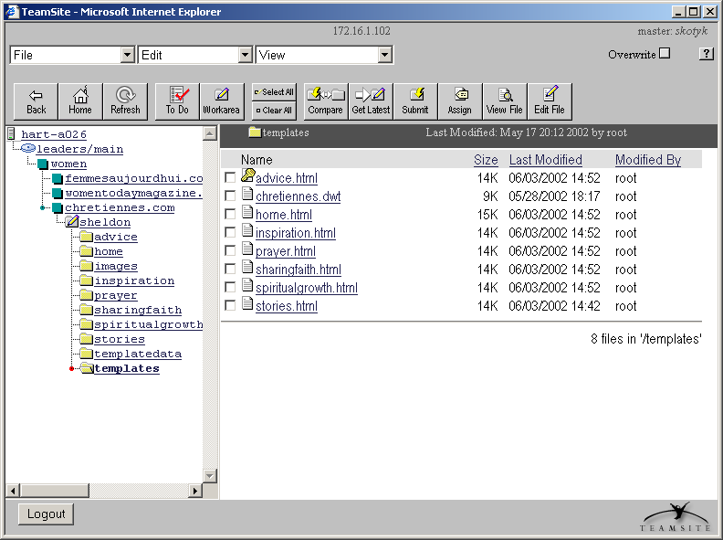
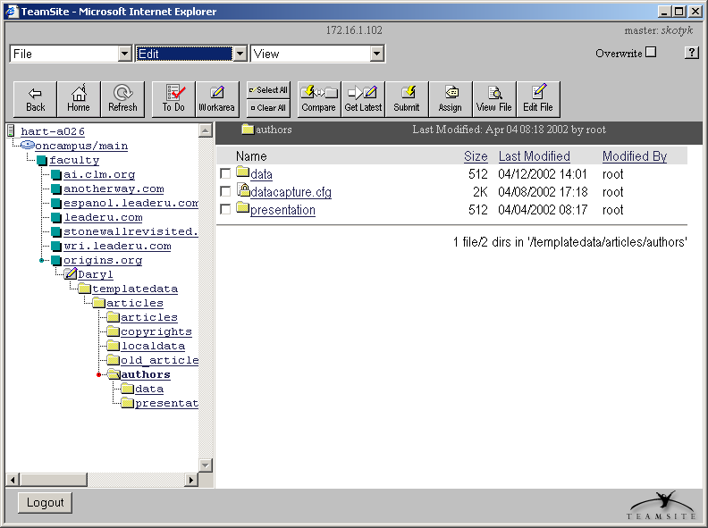
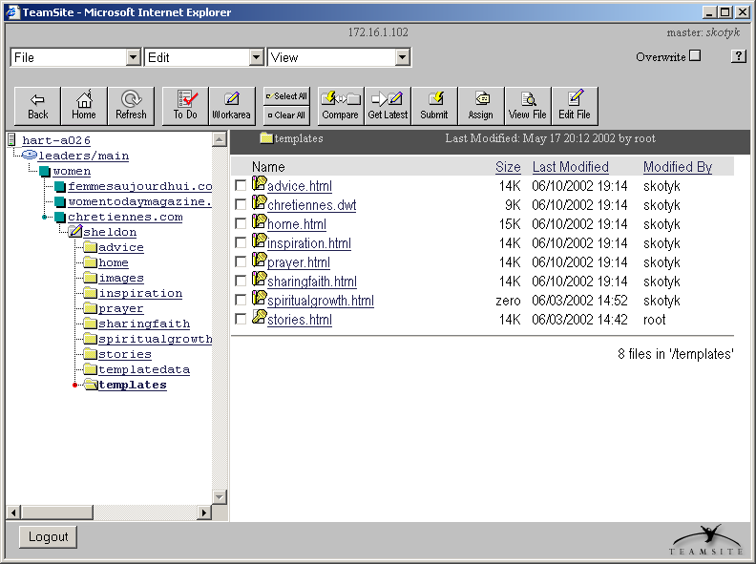
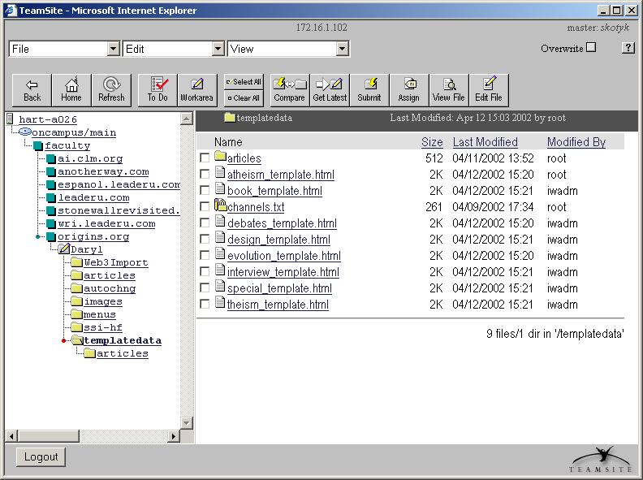
Locking Files
Implicit locks are placed on files during these commands
  New File, Rename and Edit
To manually lock a file
  Select Edit > Lock
  Locking a file manually compares the file in your Workarea with the one in staging then takes the most recent version.
  To determine who owns a lock, use File > File Properties
  A key means you own the lock
  A pencil means the file has been edited.

Slide 16
Locking Files II
If you do not own the lock, do not try to edit the file!
  If a dialog box shows up with the option to edit anyway, don’t!
  Until editors are familiar with the compare tool… this will cause problems and make Sheldon and team, mad.
  Instead, use File > File Properties to find out who owns the lock, contact them and wait for them to unlock the file.

Slide 17
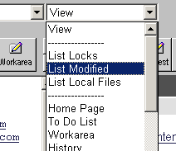
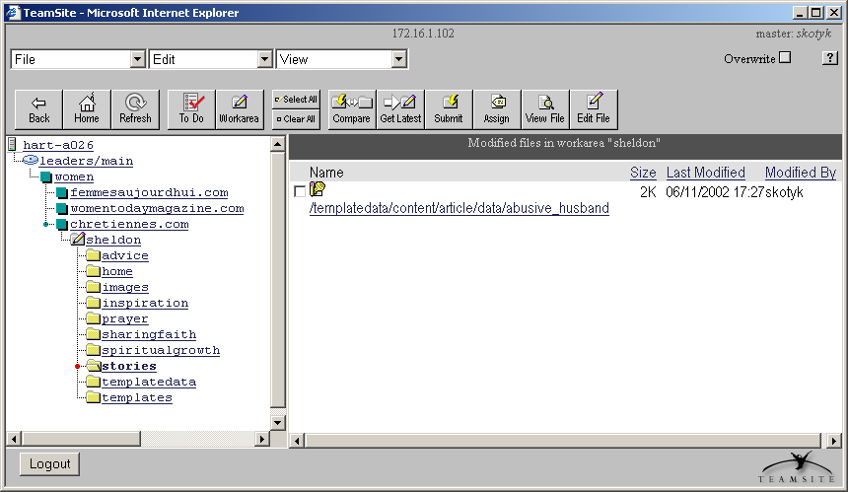
Listing Modifications in the Workarea

Slide 18
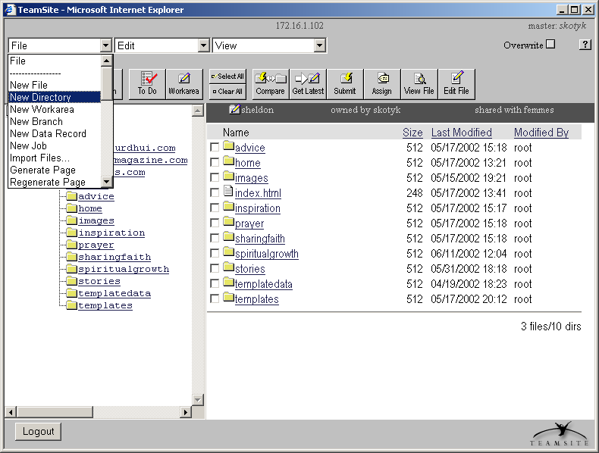
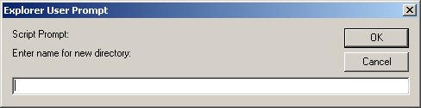
Creating a
New Directory
Note:
  You must be in your workarea

Slide 19
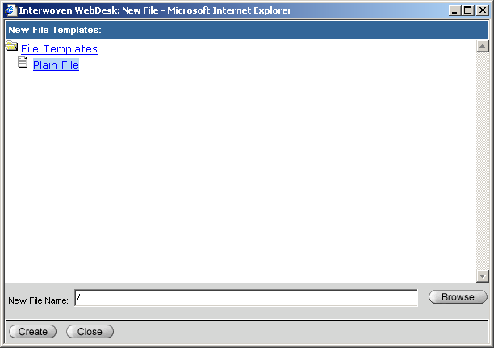
Creating a
New File
Note:
  You must be in your workarea

Slide 20
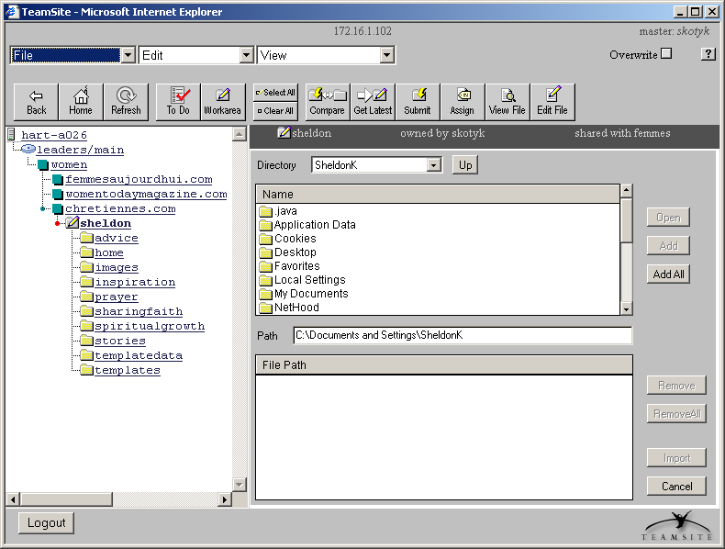
Importing a File
  Select the directory on the server on the left hand
  Find the file on your local drive on the right

Slide 21
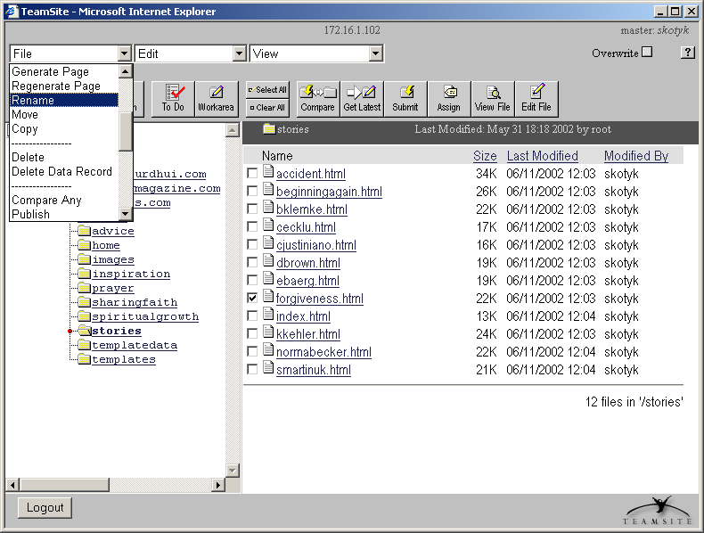
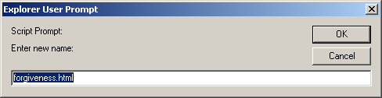
Renaming Files and
Directories

Slide 22
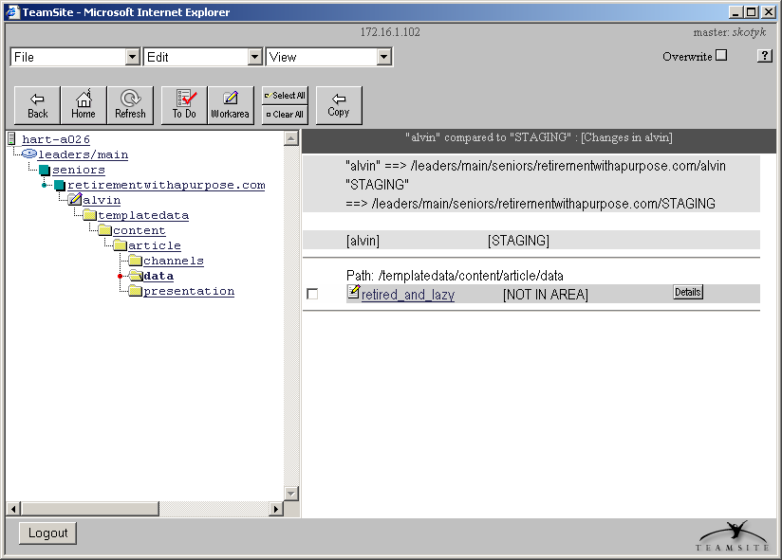
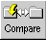
Comparing the Workarea with Staging

Slide 23
Submitting Files to Staging
You can submit to the staging area all files from your entire workarea, selected files, or directories.
When you submit a file, that file is versioned in TeamSite and it replaces versions of that file in the staging area.
When you submit a directory, only the modified files are submitted to the staging area.
After you submit a file, the lock on the file is released.

Slide 24

Deleting Files from the Staging Area
The staging area is read-only
To delete files or directories from the staging area
  Delete the file from your workarea
    Use File > Delete
  To select the deleted files or directories to submit to the staging area, use View > List Modified
  Check the Overwrite button
  Submit the selected deletions

Slide 25
Get Latest Command
To update your workarea with changes submitted by other users, use Get Latest
By default, Get Latest updates files that you have NOT modified.
If you don’t want other user’s updated files in your workarea, then wait to update your workarea.
Be careful when you use Get Latest with Overwrite. You will lose the changes you have already made to the selected file or directory.

Slide 26
File History
Several TeamSite features allow you to work with historical files.
Compare Any
View File History
Reverting to Previous Versions

Slide 27
Compare Any
You can compare any two areas
  Compare two editions
  Compare staging with a workarea
  Compare two workareas
To compare
  Use the File > Compare Any command
  Select the two areas to be compared in the Work Window.
  TeamSite lists the differences in the Work Window.

Slide 28
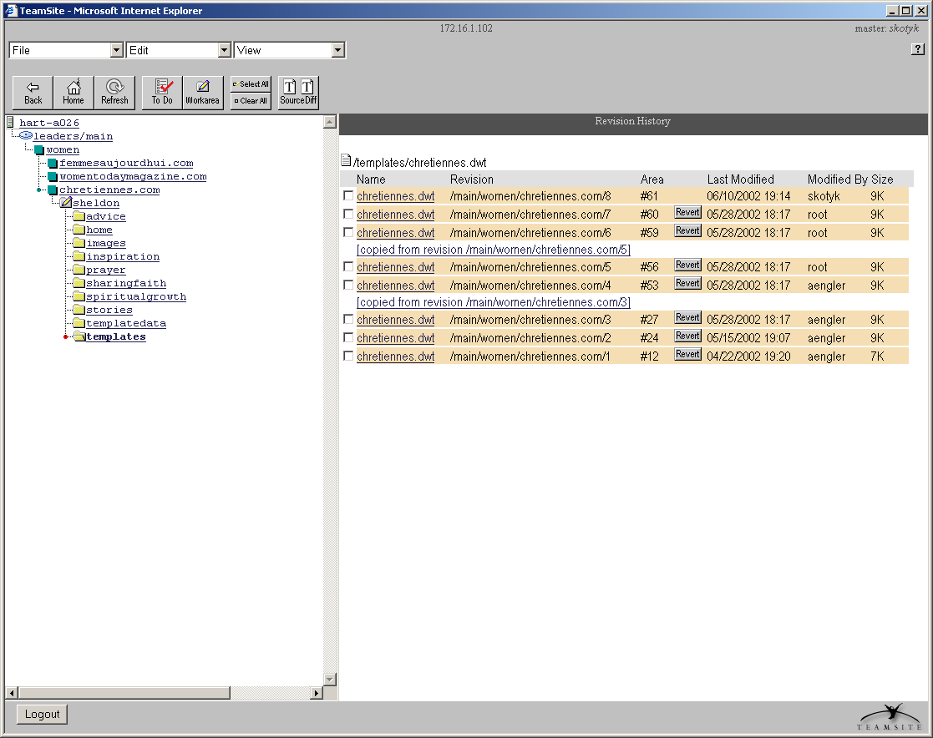
View File History

Slide 29
TeamSite Version Control
TeamSite provides versioning in two ways
  File Versioning
  Website Versioning
File Versioning
  Versions files every time they are submitted to the staging area
  Old versions can be accessed or reverted to at any time
Website Versioning
  Uses editions to version the entire website
  Editions allow users to view the entire website as it appeared in that point in time

Slide 30
Reverting to Previous Versions
Viewing File History provides you with a mechanism to revert to a previous version
To bring the older version of the file into your workarea, click the Revert button
You can submit the reverted version to the staging area

Slide 31
Publishing Editions
An edition is a read-only snapshot of all the files in a staging area
Authors can not create editions – Editors typically create editions
To publish an edition
  Navigate to the branch to publish
  Click the Publish button or use the File > Publish command

Slide 32
DCR’s, DTD’s, PT’s and other Letters
DTD: the rules that are used to build a DCT
  Stands for Document Type Definition
  You don’t need to worry about this unless you want to change the form
DCT: The form you fill in when you create or change articles
  Stands for Data Capture Template
DCR: The actual article
  Stands for Data Content Record
  Is created when you save the form
  Is married to a PT to create an html file
PT: The Look and feel of the page
  Stands for Presentation Template

Slide 33
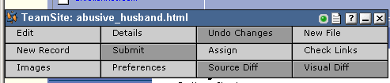
Creating DCRs
To create a Data Content Record
  Make sure you are in the right workarea
  Select File > New Data Record
  Select a template category and type (usually Content : Article)
  Enter the data into the DCT
  Save the Record (do not put .dcr or .html)
Or for the more visual (if applicable)
  View a generated file that is already done and the same type of content
  Select New Record from the SmartContext Task Bar

Slide 34
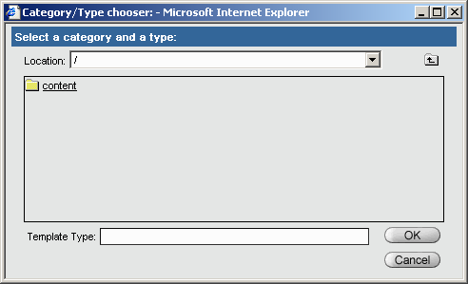
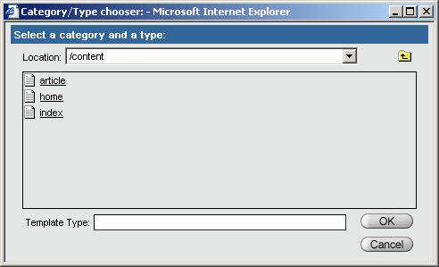
Selecting Template Category and Type

Slide 35
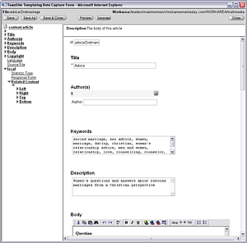
The Article Template
Articles are the most common type of content
  If it will work in the article format, this is the best option.
  Global Fields can be syndicated
  and most are required.
  Local Fields are for ministry
  or site specific needs.
  The ID field is for syndication
  purposes to allow images to
  be matched with the article.
  When a DCR is renamed it
  needs to be renamed here.
  The Title field is displayed in
  the Presentation.

Slide 36
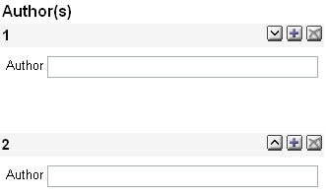
The Article Template (Author)
The Author Field
  First Name then Last Name.
  Do not put ‘by’ or ‘and’ within the field. These are for display and are in the presentation template.
  For multiple authors, enter
  each in their own box. By
  clicking on the
  button another box will
  appear. Use the button
  to remove a box. To change
  the order, use the
  buttons.

Slide 37
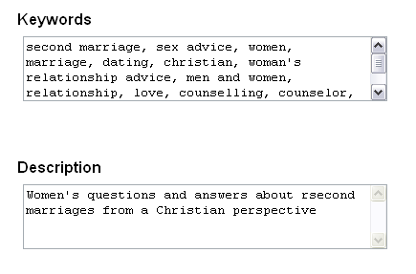
The Article Template (Metadata)
Metadata
  Keywords and Description are used for Search Engines.
  Keywords can be separated by a space or a comma.
  The Description field is
  a basic description of the
  article.
  These fields should be
  filled in by someone
  familiar with Metadata.
  Eventually, we will have a
  program to offer suggested
  Keywords and Descriptions

Slide 38
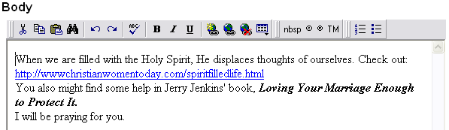
The Article Template (Body)
The Body
  The body is the main part of the article. Everything in the body will be syndicated (if applicable), therefore, display other than images and a few other details are not to be used.
  The VisualFormat bar will need to be installed for WYSIWYG editing.

Slide 39
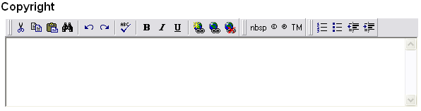
The Article Template (Copyright)
The Copyright Field
  The copyright field is NOT syndicated, therefore if a copyright notice needs to be displayed on the live site, you need to include it in the body.
  The copyright field is used for internal purposes and should include contact information if the article was syndicated for use on your site.

Slide 40
The Article Template (Translation Fields)
Language and Source File
  The language field is for knowing what language the article is in.
  Three letter SIL ethno loge language code (see http://www.sil.org).
  Example: eng = English.
  This code is the same as the Jesus Film uses.
  The Source File field is used when the article is translated from another article. You can enter a URL or filename in this field.

Slide 41
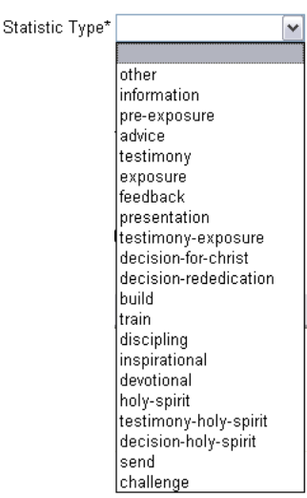
The Article Template (Statistic Type)
Statistic Type
  This drop down list is used for the CCC, Canada
  sites to track the type of article. This allows us to
  tell our donors how many evangelistic articles
  were viewed in a given month, etc.
  A definition of each type is available from
  www.TruthMedia.com/interwoven/

Slide 42
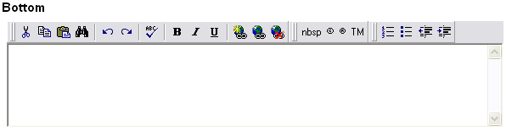
The Article Template (Related Content)
Related Content
  Many of our websites are in a magazine style format and the articles have related books, links, moderated chat sessions and other articles that the editors want to profile with the relevant article.
  These VisualFormat fields are included in the PT in different locations.
  Top | Bottom | Left | Right

Slide 43
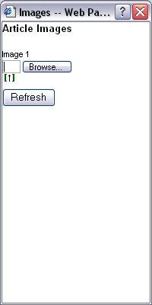

The Article Template (Images)
Images
  Images can be placed in articles inside the VisualFormat fields.
  To enable uploading of images to the IW server, a few things need to happen.
  1. You need to save the DCR with the correct filename
  and close the DCR. When you open the article again
  a pop-up box will show up called images. This box is
  where all images are loaded into before they can be
  inserted into an article.
  2. Make sure the image you want is saved on your
  hard drive.
  3. Click on the browse button. This
  will pop open a box where you can
  find the file on your computer.

Slide 44
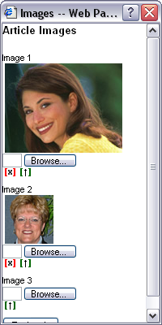
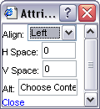
The Article Template (Images)
Images
  When you find the file, select it, the filename will
  show up in the text box. Click on the little green
  button below that to upload it to the server. (Wait
  for the box to refresh and your picture should
  be there.)
  Once the picture is there you can drag and drop it
  into one of the fields that allow it.
  Once it is in the body you can double click on it to
  get the image properties box.
  Note: Occasionally, instead of an
  Image you may only see a red x.

Slide 45

The Index Template
Building Index Pages
  Index templates built on the needs of the site.
  The TruthMedia magazines all need the ability for the editor to choose placement of the article on the template as well as images, teaser paragraphs, or channel the article was created for.
  The displayname field corresponds to the
  ‘Presented’ index name.
  The show_toplist field allows a top articles list on an index page.
  The toplist is created via a toplist dct.
  The Keywords and Description fields
  are for Metadata for search engines
  to spider and are not displayed other than in the source.

Slide 46
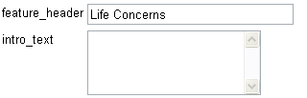
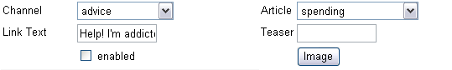
The Index Template
Building Index Pages
  The Feature header field is
  used in certain displays
  The intro text is used for
  ‘archive’ style indexes
  The features and article replicants are where articles are linked in an index. You can choose the channel the article is saved in, as well as the article through the drop down boxes. The Link Text field is the first phrase which links to the article. The teaser is the paragraph beside.
  You can also attach an image.

